Slide 1
Planning for a Productive Summer
UW ADVANCE Mentoring-for-Leadership Lunch
June 8, 2015
Joyce Yen

Slide 2
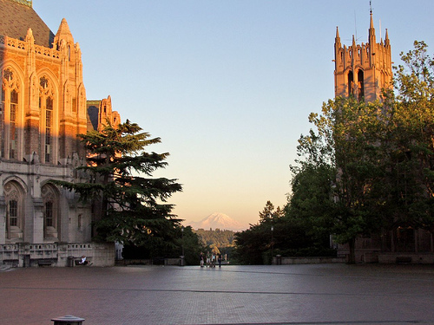
Today’s Activities
Reflection
Making a Plan
Accountability

Slide 3
Reflection
What were the characteristics of your best summer?
Personally
Professionally

Slide 4
Reflection
What were the characteristics of your best summer?
BOTH
Personal
Professional

Slide 5
Covey’s Four Quadrants
Urgent
Not Urgent
I
II
Summer
Important
III
IV
Not Important
Stephen Covey & Colleagues’ Classic Model
7 Habits of Highly Effective People, 1989 First Things First, 1994

Slide 6
Step 1: Goals
List your personal and professional summer goals.
S: Specific
M: Measurable
A: Attractive (Attainable)
R: Realistic
T: Time frame
Adapted from National Center for Faculty Development and Diversity. http://www.facultydiversity.org/?page=email0511a

Slide 7
Sample Goals Table
 | Goal 1: Write Daily | Goal 2: Submit Paper | Goal 3: Exercise Regularly | Goal 4 | Goal 5
S: Specific
M: Measurable
A: Attractive
R: Realistic
T: Time Frame
Write for 30 minutes twice a day for 4 days each week beginning 6/16
Bike to work 3 days a week, take 45 minute walk 3 days a week
Write results draft for paper by July 10th.

Slide 8

Step 2: Outline Tasks
For each goal, list/map out/flow chart all tasks (specific, in detail) needed to achieve the goal.
Adapted from National Center for Faculty Development and Diversity. http://www.facultydiversity.org/?page=email0511a

Slide 9
Sample Tasks for Write Daily Goal
Make a list of writing projects
Determine best time of day
Determine locations for writing
Set up tracking log
Pick a reward
Turn off distractors
Schedule time into calendar
Write!

Slide 10

Step 3: Map Tasks to Time
Realistic estimate
Buffer space
Specific
Reassess goals, priorities, plans
Adapted from National Center for Faculty Development and Diversity. http://www.facultydiversity.org/?page=email0511a

Slide 11
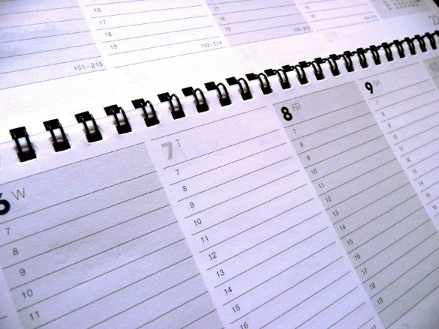
Map to Time: Write Daily Goal Tasks
Make a list of writing projects: 10 – 11 am on 6/11
Determine best times of day: 12 – 12:30 pm on 6/9
Determine locations for writing: 12 – 12:30 pm on 6/9
Set up tracking log: 12 – 12:30 pm on 6/9
Pick a reward: 12 – 12:30 pm on 6/9
Turn off distractors: 6/16 (Start day!!)
Schedule time into calendar: 3:30 – 4 pm on 6/12
Start writing!: 6/16
Goal: start writing daily on 6/16.
All tasks must be done before 6/16.

Slide 12
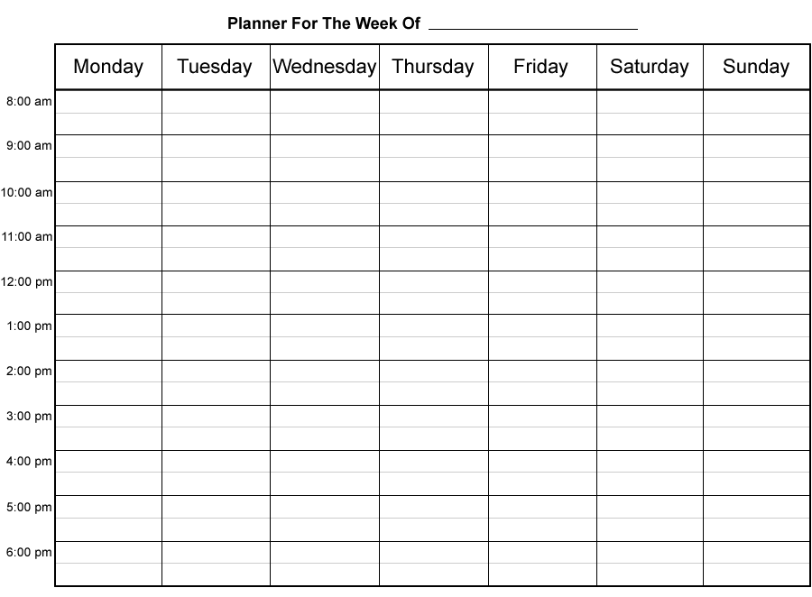

Step 4: Execute Plan Daily
Weekly review – schedule time
Rewards
Looking ahead
Changes
Adapted from National Center for Faculty Development and Diversity. http://www.facultydiversity.org/?page=email0511a

Slide 13
Step 5: Accountability
Brainstorm accountability mechanisms
Example: Writing Productivity
From Boice’s Writing Workshops:
control group (no change in writing habit.. Occasional and in big chunks of time) avg 17 p/year
Group 1 wrote daily and kept record avg. 64p/year
Group 2 wrote daily, kept record, accountable to a colleague weekly avg. 157p/year
Faculty who wrote daily spent about 2x time as those who wrote in big chunks of time, but wrote or edited 10x pages.
Adapted from National Center for Faculty Development and Diversity. http://www.facultydiversity.org/?page=email0511a

Slide 14
Step 5: Accountability
Which accountability strategies will you use?
Adapted from National Center for Faculty Development and Diversity. http://www.facultydiversity.org/?page=email0511a

Slide 15
Carrying into the Academic Year
Urgent
Not Urgent
Being Strategic
What’s Important
Making a plan
Goals
Tasks
Map to schedule
Execute
Accountability
I
II
Important
III
IV
Not Important

Slide 16
Next Steps
Block out time to finish your summer planning (all steps)
Block out time at the end of the summer to plan for Fall quarter
Commit to accountability options that work for you
Have a great summer!!

Slide 18
My Goals Table
 | Goal 1 | Goal 2 | Goal 3 | Goal 4 | Goal 5
S: Specific
M: Measurable
A: Attractive
R: Realistic
T: Time Frame

